Slide 1
WCO Anti-Corruption and Integrity Promotion (A-CIP) Programme in WCA Region
Jean-Christophe LENEUTRE
A-CIP Programme Expert
Regional Meeting of the DGs of Customs Administrations WCO West and Central Africa Region
4 May 2023

Slide 2
WCO A-CIP Programme & WCA
S
T
A
R
T
1
Customs, Corruption and WCO Response
2
WCO Anti-Corruption and Integrity Promotion (A-CIP) Programme
3
WCO A-CIP Programme in the WCA region
A-CIP Programme and West and Central Africa Region

Slide 3


Consequences of Corruption in Customs
Corruption is an obstacle to all Customs’ missions: revenue collection, trade facilitation, enforcement, safety and security, quality of service, …
A-CIP Programme and West and Central Africa Region
Notes:
“Loss of revenue caused by customs-related corruption is estimated to cost WCO members at least USD 2 billion in customs revenue each year.”*

Slide 4



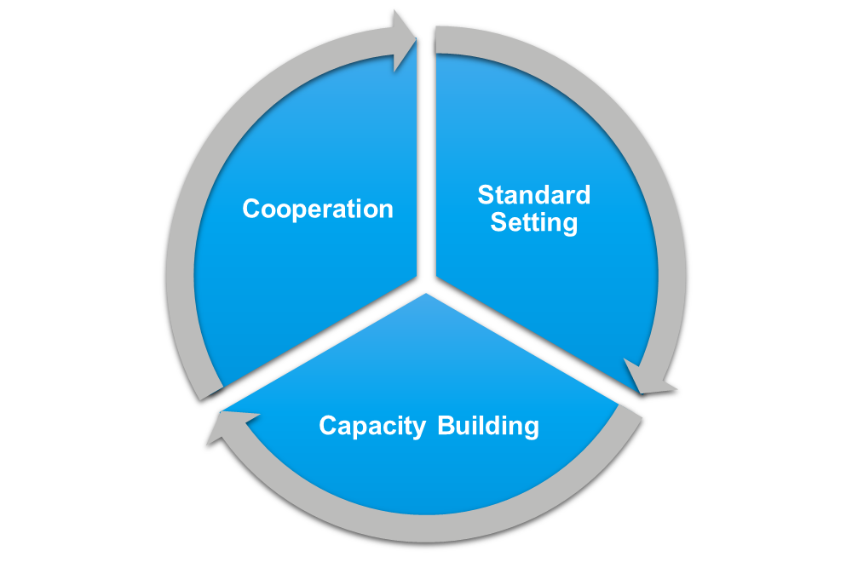

WCO Response
WCO Integrity Sub-Committee (ISC)
WCO Revised Arusha Declaration Concerning Good Governance and Integrity in Customs
+ WCO Integrity Tools & Instruments
WCO Anti-Corruption and Integrity Promotion (A-CIP) Programme for Customs
A-CIP Programme and West and Central Africa Region

Slide 5






WCO Assistance for Integrity
The WCO’s model for technical assistance and capacity building (TACB) aims to add value by drawing from the WCO’s strongest competencies:
Peer-to-peer information sharing and collaboration
Access to experiences and expertise
Use of WCO tools and instruments
Monitoring and evaluation
Improved business and law enforcement environments for cross-border trade for WCO Member countries
Assists WCO Members to implement new measures to combat corruption and promote integrity in accordance with the Revised Arusha Declaration.
A-CIP Programme and West and Central Africa Region

Slide 6

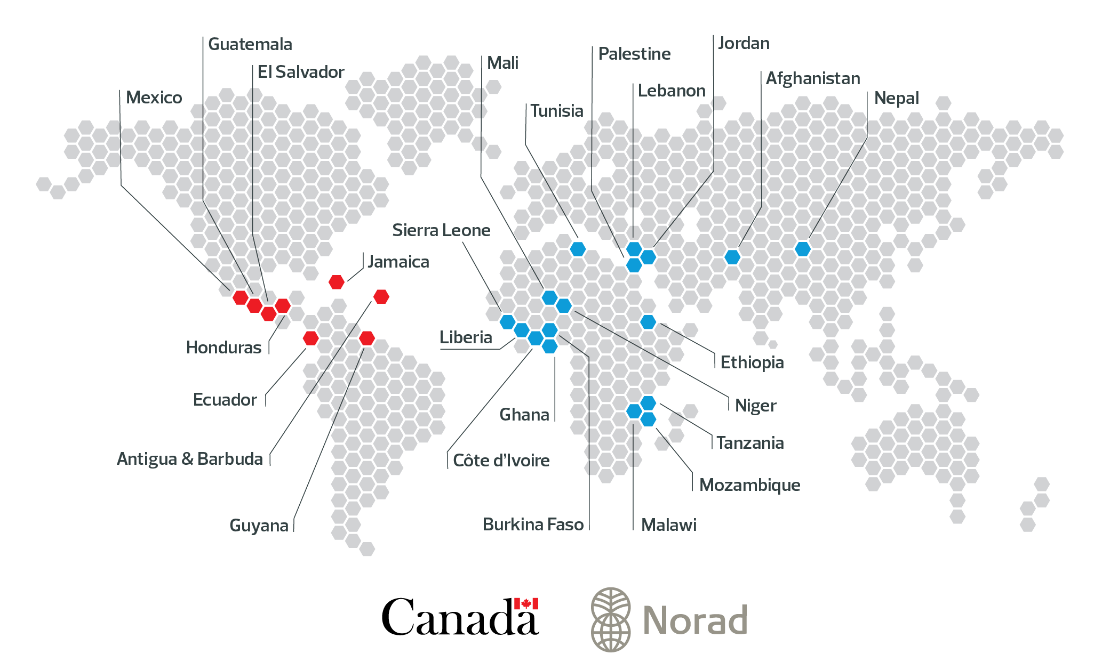
Partner Administrations
A-CIP Programme and West and Central Africa Region

Slide 7
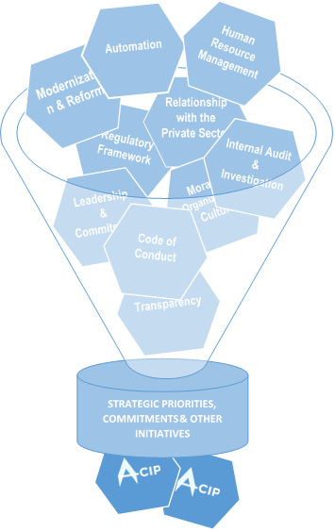
A-CIP Support to Partner Administrations
Current needs, gaps identified
Internal and external strategic objectives
Other ongoing initiatives
Where the WCO can add value
Country-level
A-CIP Project Information Documents (PIDs)
A-CIP Programme and West and Central Africa Region

Slide 8
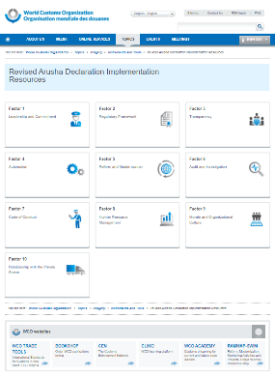

Increasing Access to and use of WCO Tools
Search: WCO Revised Arusha Declaration Resources|
A-CIP Programme and West and Central Africa Region

Slide 9
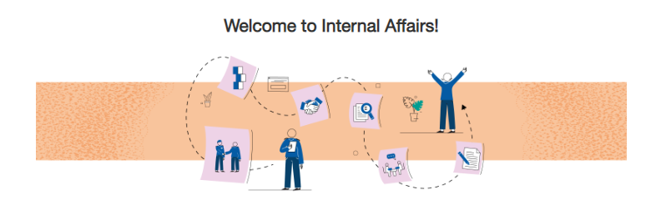

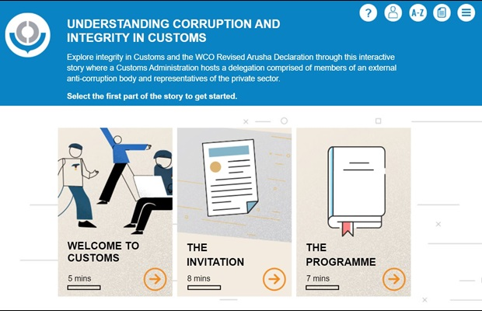
Increasing Access to and Use of WCO e-Learning Products
EN, FR, ES, PT …
Included are 4 videos clips that emphasize key messages
How is corruption prevented and reported?
How is an administrative investigation conducted?
How is an interview conducted?
How is an effective investigation report written?
https://www.youtube.com/watch?v=0deuwkm7hKc
A-CIP Programme and West and Central Africa Region

Slide 10
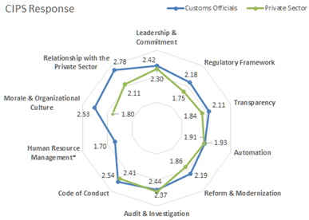
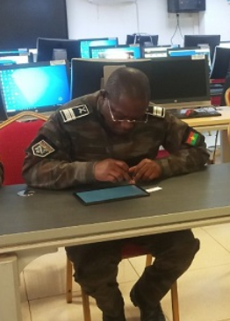
Customs Integrity Perception Survey (CIPS)
Step 1 Develop the methodological guidelines based on RAD
Step 2 Conduct the survey in partner countries
Step 3 Analyse the data
Step 4 Consolidate action plans
Step 5 Repeat survey
A-CIP Programme and West and Central Africa Region

Slide 11

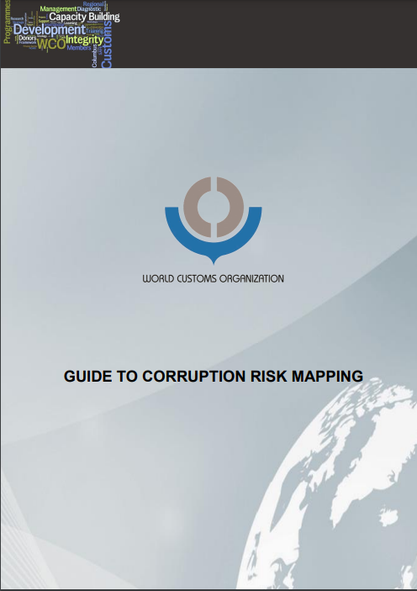
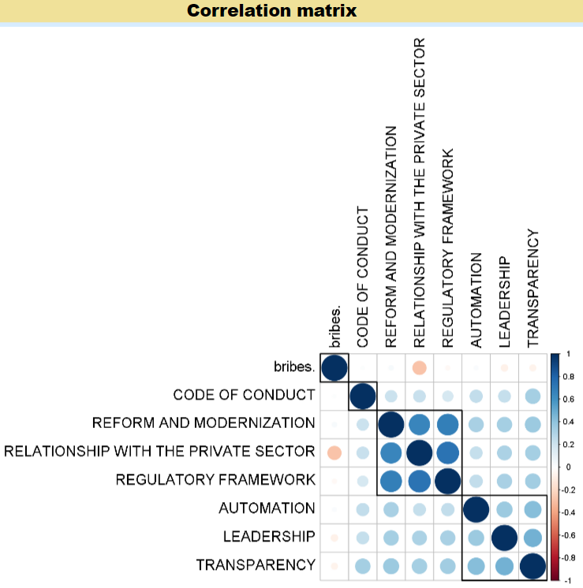
The way ahead
A-CIP Programme implementation and follow-up actions
Integrity culture and Internal Affairs training curriculum
Supplement to the WCO Guide to Corruption Risk Mapping: mapping operations
CIPS global data analysis
Training of trainers A-CPI
…
A-CIP Programme and West and Central Africa Region

Slide 12
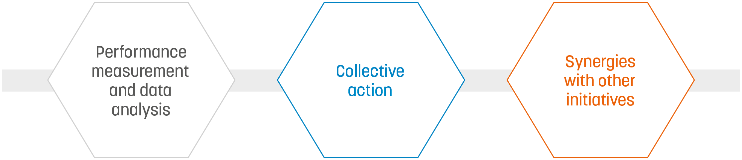


Principles for Results Countering Corruption in Customs
A-CIP Programme and West and Central Africa Region

Slide 13
Thank you
Jean-Christophe LENEUTRE
A-CIP Programme Expert
jean-christophe.leneutre@wcoomd.org

